Slide 1
Emotion Coaching – March 2020

Slide 2
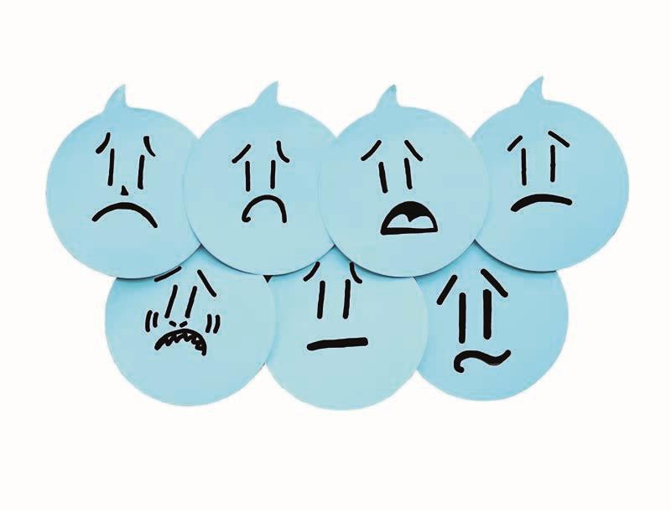
Why do Emotion Coaching?
Emotion Coaching is an evidence-based strategy based upon the work of psychologist John Gottman.
Emotion Coached people are better able to:
control their impulses
self soothe when upset
pay attention
As a result, Emotion Coached children
Achieve more academically in school
Are more popular
Have fewer behavioural problems
Have fewer infectious illnesses
Are more emotionally stable
Are more resilient

Slide 3
Why do Emotion Coaching?
Research in the UK has echoed findings from parental work in educational and community settings. The findings demonstrate that Emotion Coaching helps:
children to regulate, improve and take ownership of their behaviour
children to calm down and better understand emotions
practitioners to be more sensitive to children’s needs
create more consistent responses to children’s behaviour
practitioners to feel more ‘in control’ during incidents
promotes positive relationships between adults
and children through promoting trust
academic attainment accelerates

Slide 4
Emotions – What are they??
Emotions are also called feelings - you know, like being happy or mad or scared. You feel them because of what you see, hear, remember, and do. So whether you're sad and blue, or happy and excited, you can share your feelings with other people by talking about them.
What different emotions can you think of??
Are they good or bad??

Slide 6
Why do we need Emotion Coaching?
Distress Fear Anger Disgust
Surprise Joy

Slide 7
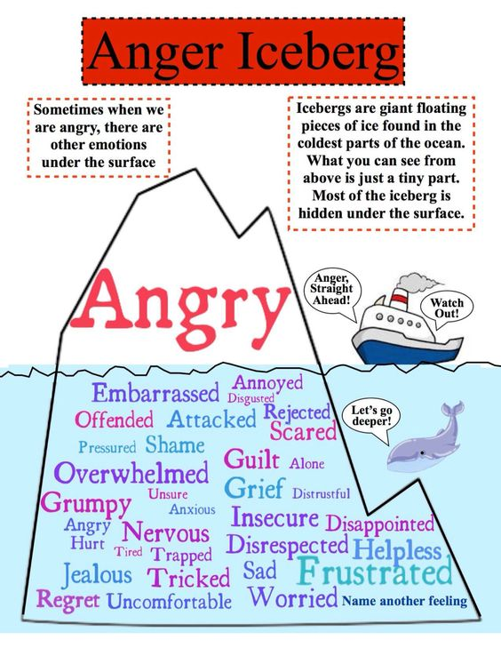

Slide 8
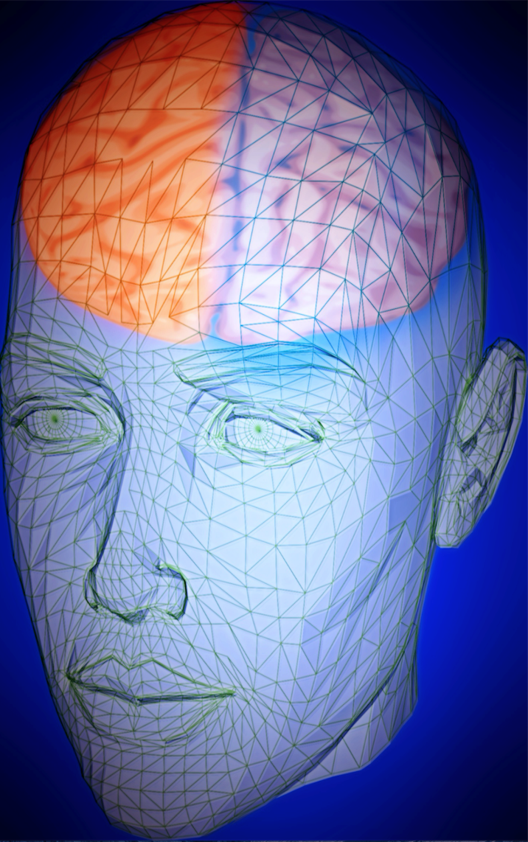
The science bit…
The lower brain (Limbic system) is where emotions are processed and connected, and memories are formed and retained.
The higher brain (Prefrontal lobes) is where movement, decision making, problem solving, planning, impulse control, memory and high order functions take place.
‘What research has yet to disprove is the fact that our brains are remarkably malleable, adapting to and reflecting changes, even in late adulthood’
© PhotomaniacDreamstime Stock Photos

Slide 9
The science bit…
The right hemisphere of the brain controls a person's cognitive skills. The right side of the brain also controls muscle movements on the left side of the body.
The left side of your brain controls the muscles on the right side of your body, and it is responsible for language along with logical and mathematical thinking.
‘What research has yet to disprove is the fact that our brains are remarkably malleable, adapting to and reflecting changes, even in late adulthood’
© PhotomaniacDreamstime Stock Photos

Slide 10
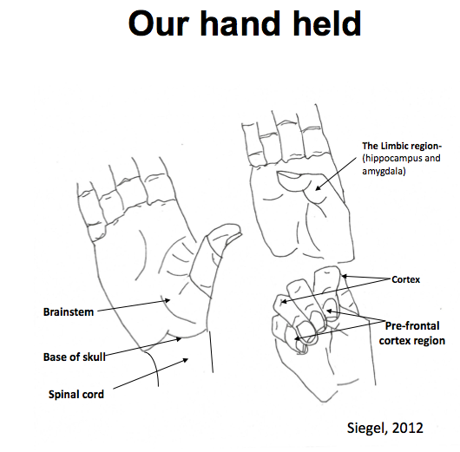

Slide 11
Emotional Regulation and Attachment
The child’s prefrontal cortex (higher brain) is functionally less mature at birth than the limbic system (lower brain), so they are easily overwhelmed by emotions.
Because neural connections between the limbic system and the prefrontal cortex are developing and proliferating, children need help and time to think, reason and calm themselves down.
With consistent, supportive, emotional responses from adults a child’s frontal cortex will develop the essential brain pathways that, over time, support self regulation to better manage alarm states in the limbic system

Slide 12
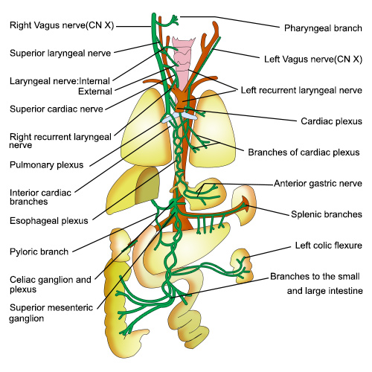
Reaction and Response when challenges are over – The Vagus Nerve
The vagus nerve runs to and from the brain throughout the body and acts on organs.
It acts as a natural ‘brake’ on bodily functions and helps to return function back to ‘normal’ after a stress-response, allowing social engagement to reoccur.

Slide 13
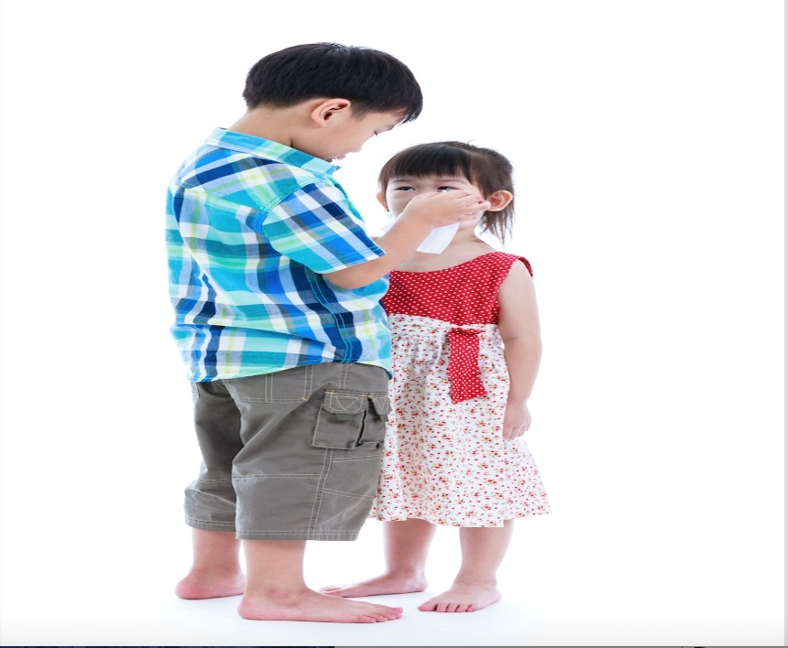
How is Vagal Tone Activated?
Initially via soothing, compassion and physical comfort
By experiencing and also practising empathy ‘co-regulation’
We learn to self- soothe and self- regulate from our ongoing relationships with parents and significant others
Attachment responses are social-learning processes
Vagal tone is important in development and maintenance of social relationships (temperament also plays a role).

Slide 14
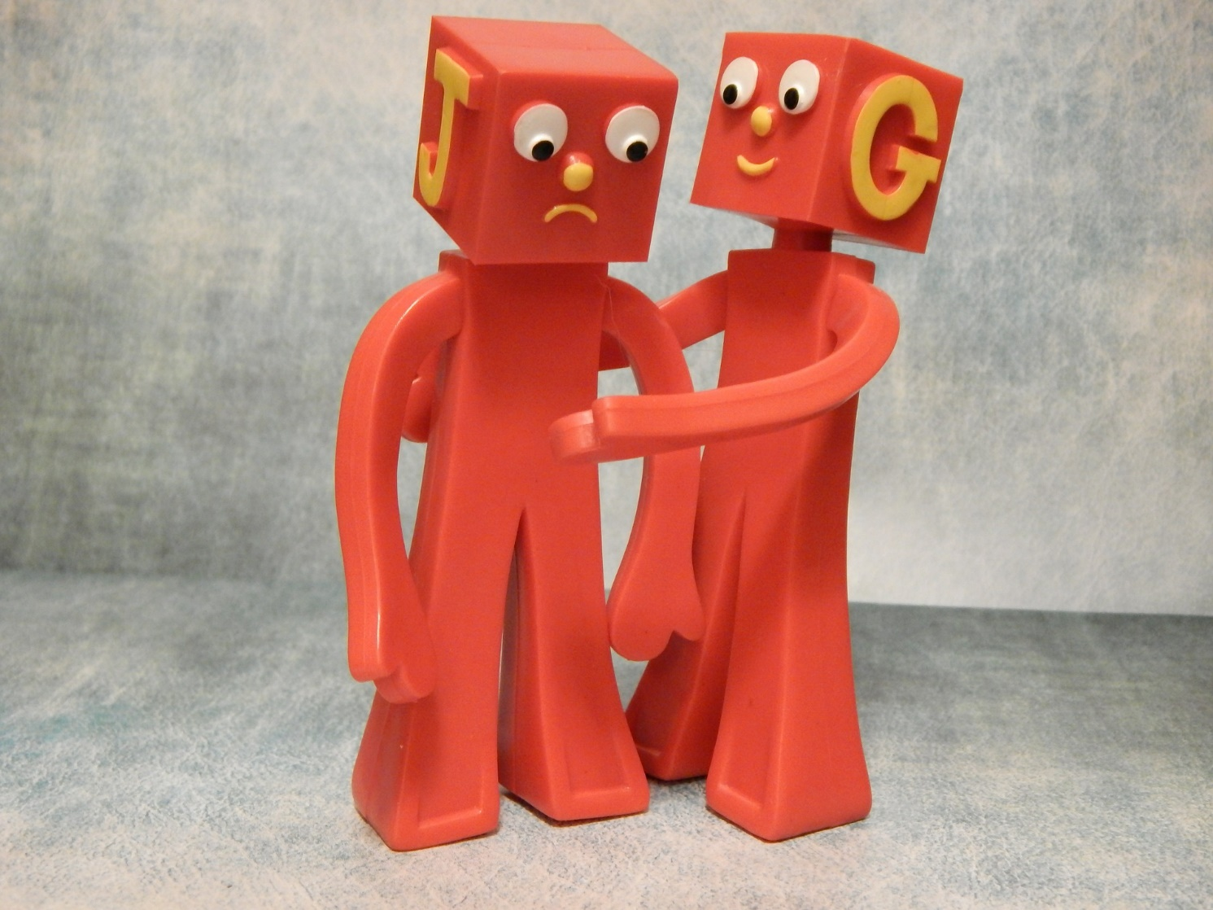
Emotion Coaching involves:
Teaching children about the world of emotion ‘in the moment’
Giving children strategies to deal with ups and downs
Accepting negative emotions as normal
Using moments of negative behaviour as opportunities for teaching
Building trusting and respectful relationships with children

Slide 15
Styles in dealing with emotions
Emotion Coaching
Emotion Dismissing
Emotion Disapproving
Laissez-faire

Slide 16
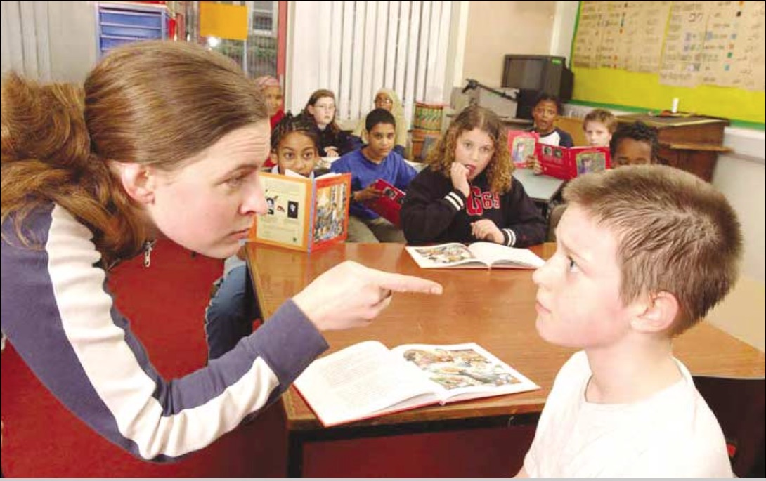
Disapproving Style
© 2005 Ross Young
Disapproves of negative emotions – viewed as a sign of weakness, lack of control, unconstructive
Lacks empathy, noticeably critical and intolerant
Tries to get rid of negative emotions via discipline, reprimand, punishment
Focuses on the behaviour rather than the emotions generating the behaviour
More likely to view negative emotional displays as a form of manipulation, lack of obedience, sign of bad character
Often motivated by need to control and regain power and/or to ‘toughen up’ child

Slide 17
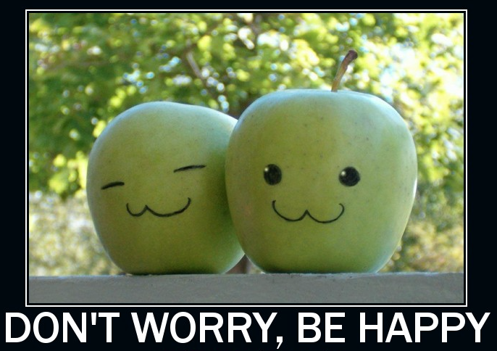
Dismissing Style
Despite good intentions (wants to make child feel better) is uncomfortable, fearful, anxious, hurt, annoyed or overwhelmed with negative emotions
Wants negative emotions to go away quickly
Considers paying attention to such emotions will make them worse, prolong them
Tries to stop negative emotions by reducing/ minimising/ making light of their importance/significance
e.g. it’s no big deal, don’t worry about it, be a big girl, that’s life, you’ll be fine
Often motivated by need to rescue and make things better, fix the problem e.g. ‘have a biscuit’, ‘I’ll buy a new one’, ‘you need to do this’
Focuses on getting rid of the emotion with logic or distraction rather than understanding the feelings

Slide 18
Effects of dismissing and disapproving styles of dealing with emotions upon children
Child learns ‘what I am feeling is not right, my assessment of the
problem is wrong, I must not feel this way’
Child does not learn to trust own feelings affecting decision-making
Not given opportunities to experience emotions and deal with them
effectively so grow up unprepared for life’s challenges
Not given opportunities to self-regulate or problem-solve
Can lead to suppression of natural emotions, less or lack of self-
regulation, reliance on distraction to get rid of emotion
Generates more negative feelings - resentment, guilt, shame, anger

Slide 19
Laissez-faire Style
Freely accepts all emotional expression from the children
Offers comfort to the child experiencing negative feelings
Offers little guidance on behaviour
Does not teach the child about emotions
Is permissive; does not set limits
Does not help children solve problems
Does not teach problem-solving methods to the child
Believes there is little you can do about negative emotions other than ride them out.
Believes that managing negative emotions is a matter of hydraulics; release the emotion and the work is done.

Slide 20
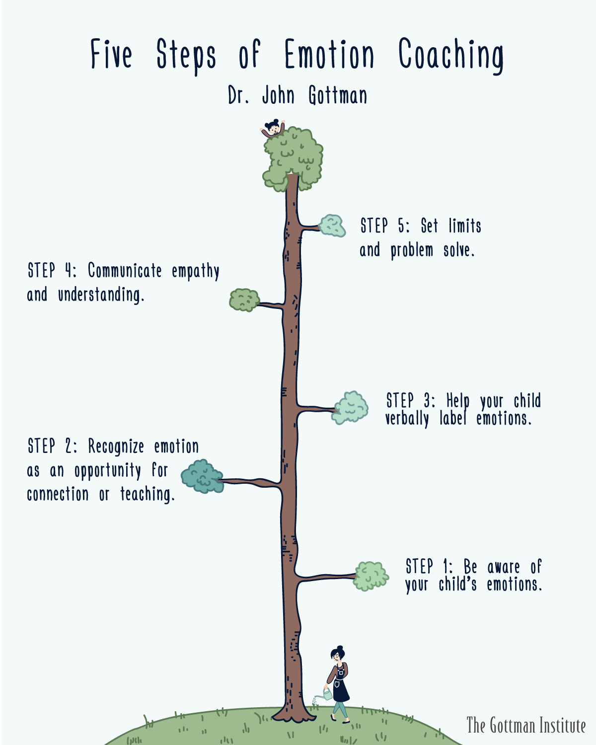
What this means in practice
Step 1
Recognising the feelings and empathising with them
Step 2
Validating the feelings and labelling them
Step 3
Setting limits on behaviour (if needed)
Step 4
Problem-solving

Slide 21
Step 1: Recognise the child’s feelings and empathise with them - “Connect before Correct”
Need to genuinely empathise with the other person from their point of view. This doesn’t mean agreeing with them, just viewing things from their perspective
Recognise all emotions as being natural and normal and not always a matter of choice
Recognise behaviour as communication
Look for physical and verbal signs of the emotion being felt
Take on the other persons perspective (mentalising/mind-mindedness)

Slide 22
Things we can do to co-regulate someone who has ‘flipped their lid’
The lowest part of the brain needs to be regulated first:
Way to do this is through rhythm: Patterned, repetitive rhythmic activities
Fight impulse:
pushing, deep touch pressure activities
Flight impulse :
running, jumping, kinaesthetic activities
These might include:
Walking, running, dancing, singing, deep breathing, colouring, trampolining, swinging, drumming, tug of war, bouncing on a fitness ball, walking along balance beam, balance board, measuring heart rate………………..

Slide 23
Things we can do to co-regulate someone who has flipped their lid
Grounding and calming strategies
Grounding helps keep someone in the present. It works by focussing outward on the external world. You can think of it as distraction, centering, a safe place or looking outward.
Strategies include:
Counting breaths in and out, watching clouds, counting backwards from 20, counting how many steps he can walk with a beanbag on his head, placing a cool cloth to their face, playing 54321 game:
Name 5 things you can see in the room
Name 4 things you can feel
Name 3 things you can hear right now
Name 2 things you can smell
Name 1 good thing about yourself
Let the other person know they are safe and secure - “I can see you and I’m going to stay near you to make sure you stay safe”.

Slide 24
Step 2: Validating the feelings and labelling them
Use words to reflect back the other persons emotion and help them to label it
Simply observe – saying what you see rather than asking probing questions
Telling the emotional person that you understand their emotional situation and that you don’t blame them helps sooth their emotional brain
“Proposing solutions before empathising is like trying to build the frame of a house before you lay a firm foundation” (Gottman)

Slide 25
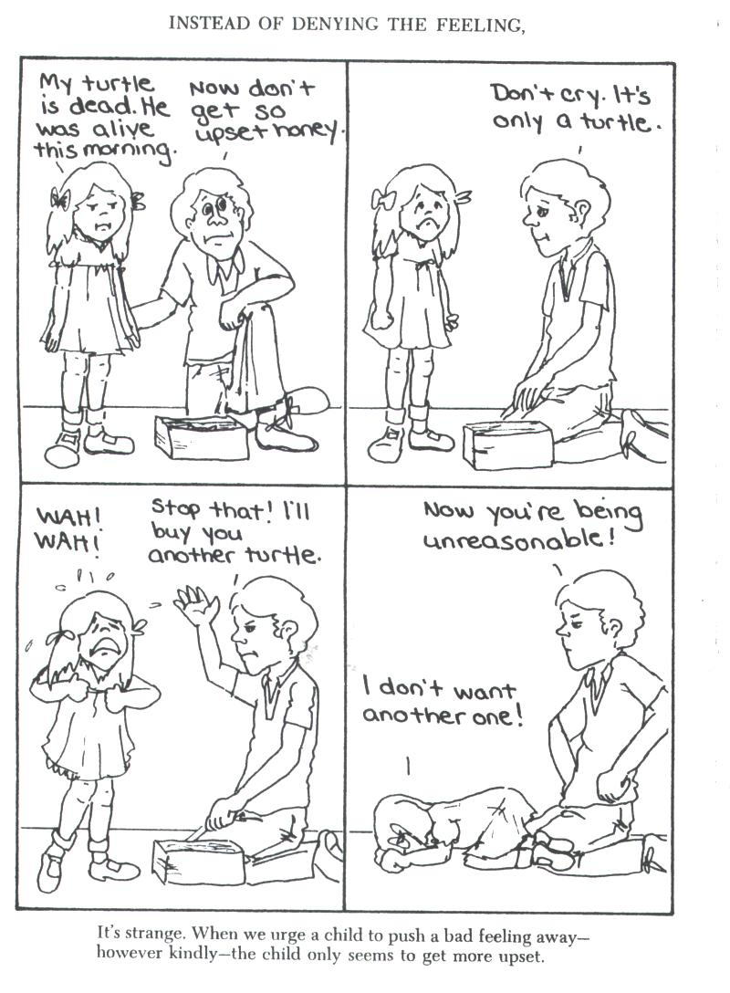
Instead of denying the feeling …

Slide 26
Empathise, validate, label…
Faber and Mazlish (2001) How to talk to kids so kids will listen

Slide 27
Step 1&2 : Hints
Acknowledge low levels of emotion before they escalate to full-blown crisis.
Acknowledge all emotions as being natural and normal and not always a matter of choice.
Recognise behaviour as communicative
Demonstrating empathy when stakes
are low creates a good foundation.
You become the child’s ally.

Slide 28
Co-regulation, emotional behavioural regulation and Emotion Coaching
‘I understand how you feel, you’re not alone’
‘This is what is happening, this is what you’re feeling’
‘We can’t always get what we want’
‘We can sort this out’
Notes:
Can do so by ‘containing’ – sharing, supporting and ‘carrying’ the child’s emotional state by tuning-in/empathising –
‘I understand how you feel, you’re not alone’
Helping the child to cope with and come to terms with boundaries – ‘We can’t always get what we want’
Working with the child to resolve the problem until they can self-resolve and self-repair – ‘We can sort this out’
This ensures affect (emotional) develops in tune with cognitive (thinking) – i.e. cognitive and affective meaning of experiences

Slide 29
Step 3: Setting Limits (if needed)
State the boundary limits of acceptable behaviour (positive limit setting)
Make it clear certain behaviours cannot be accepted.
Retain other persons self-dignity
‘You are angry that I’ve taken away your phone but these are the rules everyone has to follow. I will keep it safe for you’

Slide 30
Step 4: Problem solving
When the other person is calm and in a relaxed, rational state:
Explore the feelings that give rise to the behaviour/problem/incident
Scaffold alternative ideas and actions that could lead to more appropriate and productive outcomes
Empower them to believe s/he can overcome difficulties and manage feelings/behaviour.

Slide 31
Finding solutions – problem solving
“What does your body feel like now?”
“What feelings are you having?”
“Let’s think of what we could have done instead”
“Can you think of a different way to deal with your feelings”
“I can help you to think of a different way to cope”
“Can you remember what we said before”
“Let’s sort this out”
“Try and do this next time you feel like this”
“Let’s decide what you will do next time you feel like this”
“This is what you can do instead”
What might your friend do or suggest you do?

Slide 32
Why is Emotion Coaching Effective?
Vagal tone is increased. The vagus nerve nerve calms things down and soothes the body.
Triggers an empathic mirror system.
Helps child to feel safe and calm down.
Provides a narrative for connecting emotional and cognitive processes.
Stimulates neural connections between the amygdala/limbic system and the frontal lobes. Over time the children’s brains become more integrated; the automatic emotional responses from the prehistoric or lower part of the brain become regulated by the activity in the prefrontal cortex (higher brain).
Integration of the right and left brain is supported through linking language with emotions.
Creates a process of co-regulation and ‘repair’.
Based on relationships.

Slide 33
Emotion Coaching Advantages
It is not a separate model or system, it can be used to supplement your existing policies
It is simple to use, no special time is needed to help all children to thrive (only need to use it approx. 40-60% of time!)
Teacher–pupil, adult-child relationships are enhanced
Makes adults feel more confident and positive in their relationships with children
Helps adults be calmer and have easier access to control and rationality when dealing with emotional children
Long-term universal solution to children’s well-being and resilience

